Slide 1
www.jamaatwomen.org

Slide 2
www.jamaatwomen.org

Slide 3
www.jamaatwomen.org

Slide 4
www.jamaatwomen.org

Slide 5
www.jamaatwomen.org

Slide 6
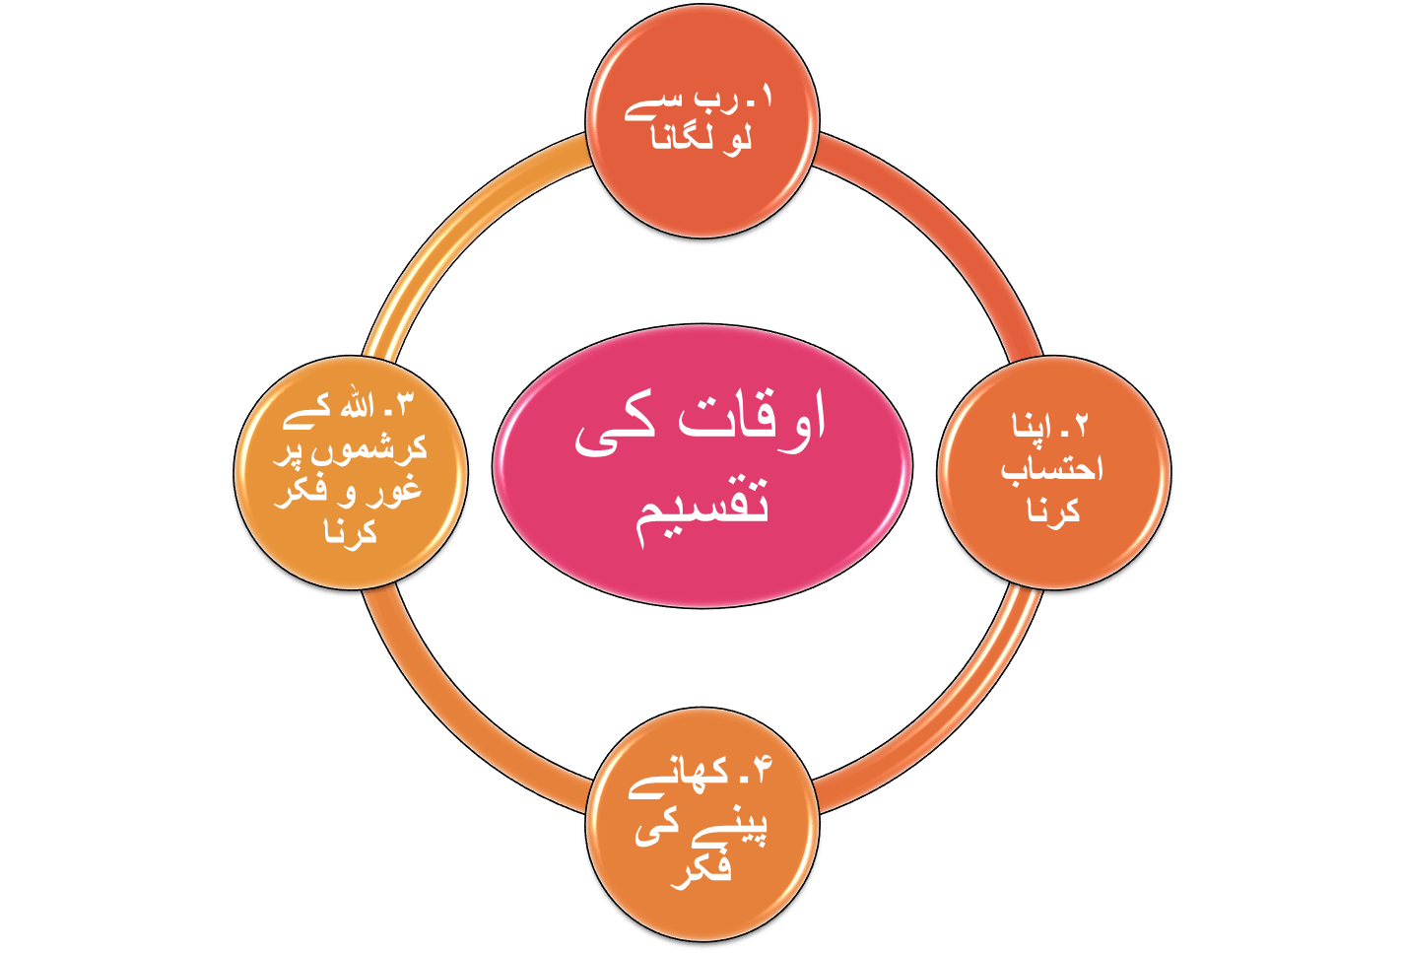
www.jamaatwomen.org

Slide 7
www.jamaatwomen.org

Slide 8
www.jamaatwomen.org

Slide 9
www.jamaatwomen.org

Slide 10
www.jamaatwomen.org

Slide 11
www.jamaatwomen.org

Slide 12
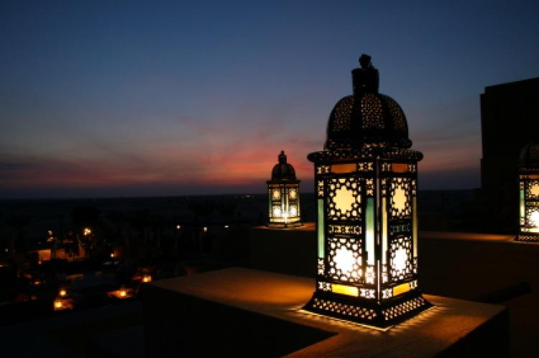
www.jamaatwomen.org

Slide 13
www.jamaatwomen.org

Slide 14
www.jamaatwomen.org

Slide 15
www.jamaatwomen.org

Slide 16
www.jamaatwomen.org

Slide 17
www.jamaatwomen.org

Slide 18
www.jamaatwomen.org

Slide 19
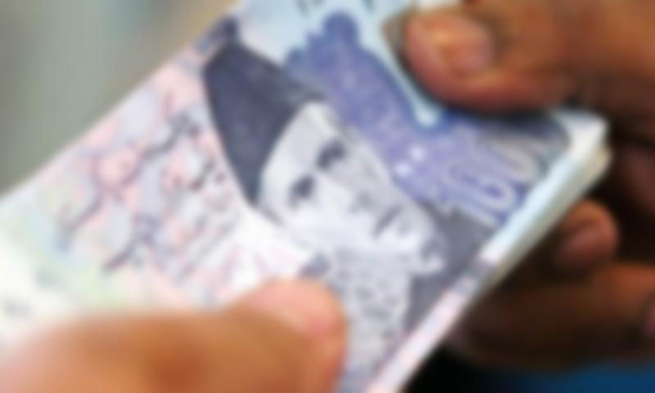
www.jamaatwomen.org

Slide 20
www.jamaatwomen.org

Slide 22
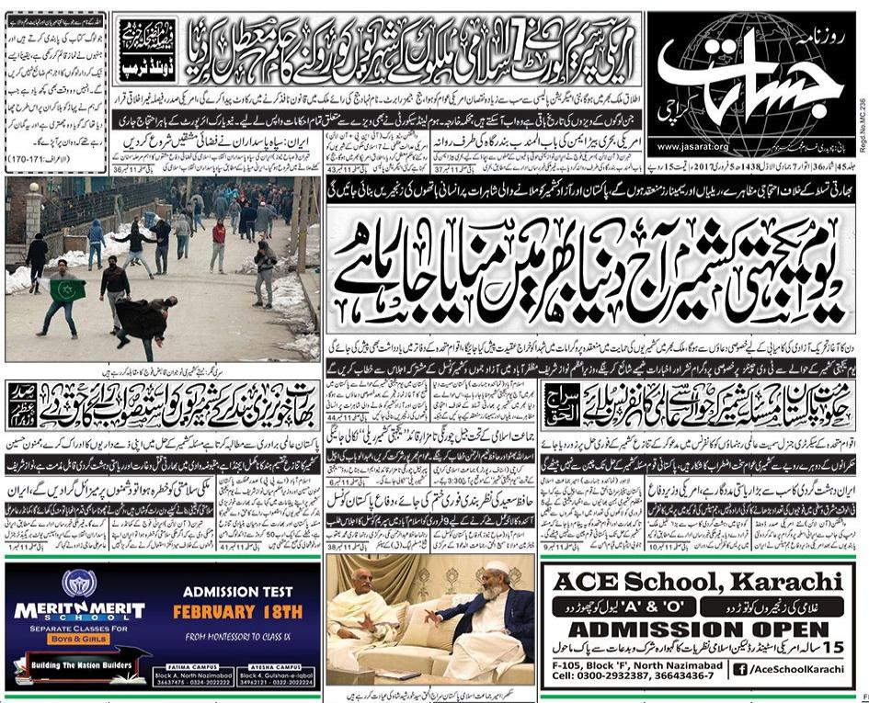
Halat e hazira sy aagahi
www.jamaatwomen.org

Slide 23
www.jamaatwomen.org

Slide 24
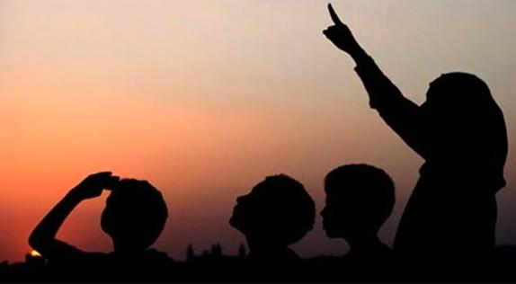
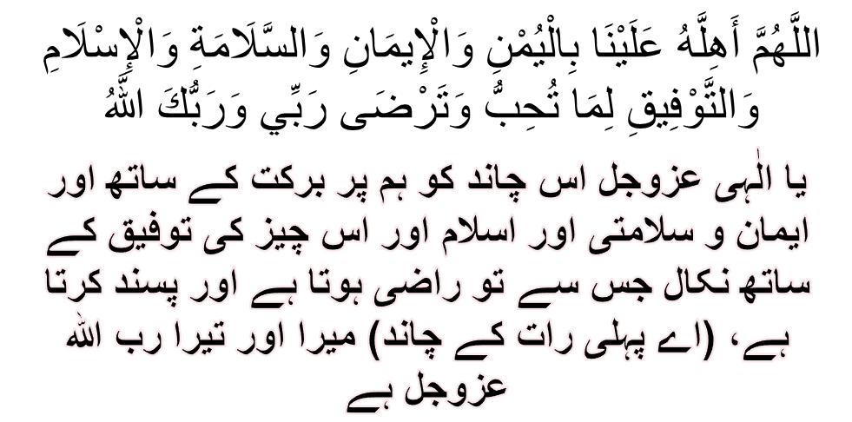
www.jamaatwomen.org

Slide 25
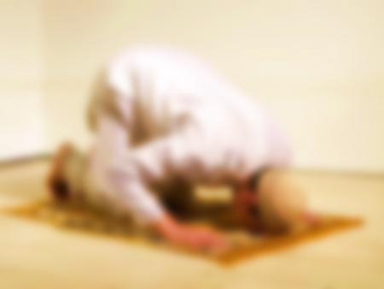
www.jamaatwomen.org

Slide 26
www.jamaatwomen.org

Slide 27
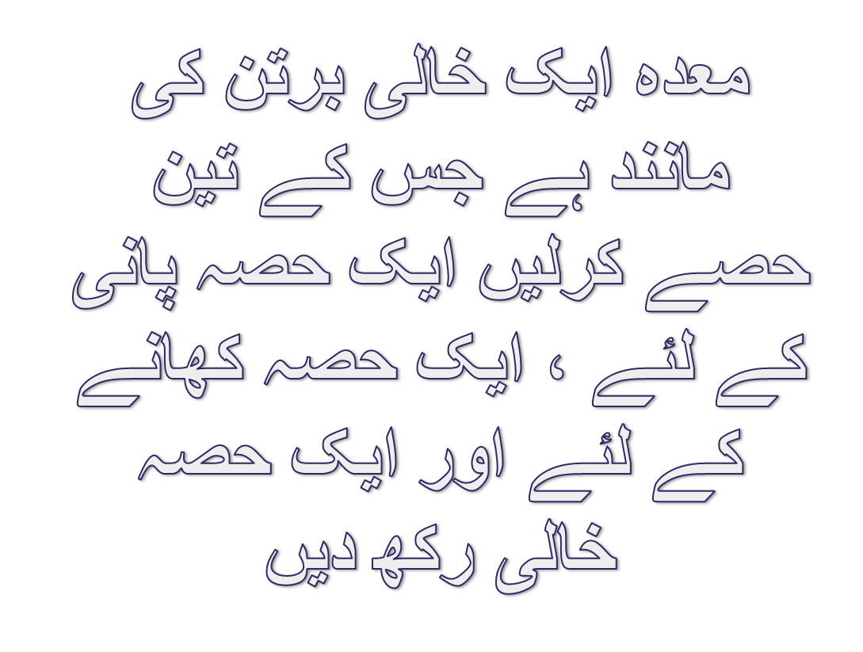
www.jamaatwomen.org

Slide 28
www.jamaatwomen.org

Slide 29
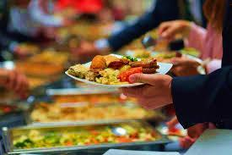
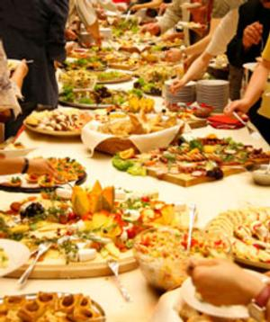
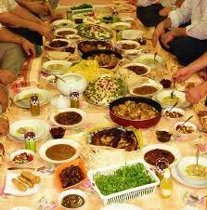
www.jamaatwomen.org

Slide 30
www.jamaatwomen.org

Slide 31
www.jamaatwomen.org

Slide 32
www.jamaatwomen.org

Slide 33
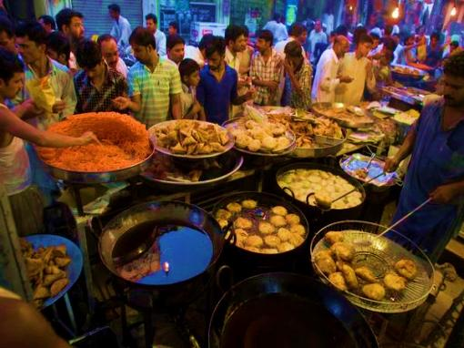
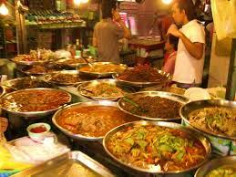
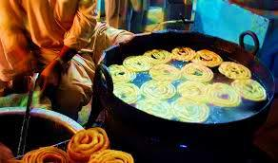
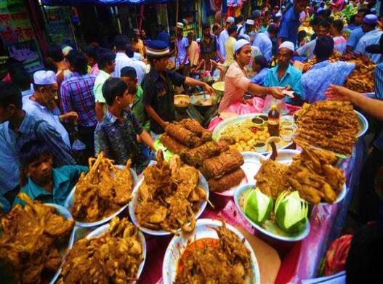
www.jamaatwomen.org

Slide 34
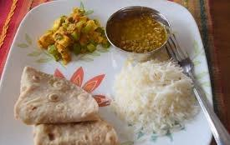
www.jamaatwomen.org

Slide 35
www.jamaatwomen.org

Slide 36
www.jamaatwomen.org

Slide 37
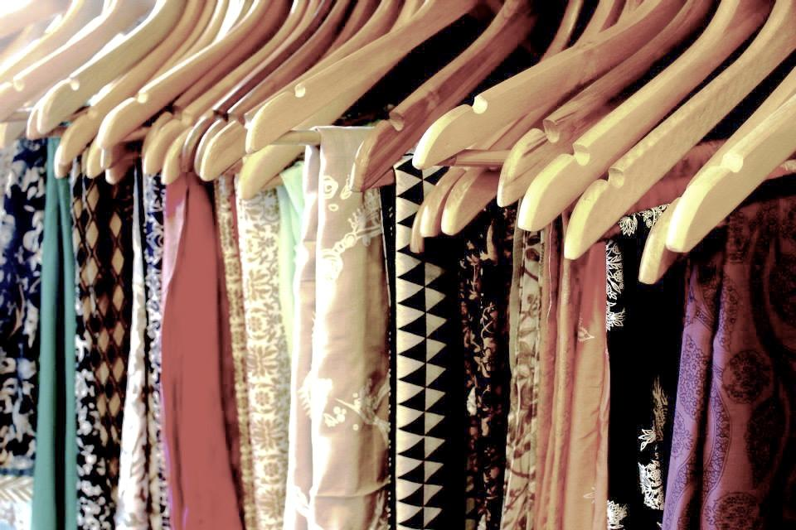
www.jamaatwomen.org

Slide 38
www.jamaatwomen.org

Slide 39
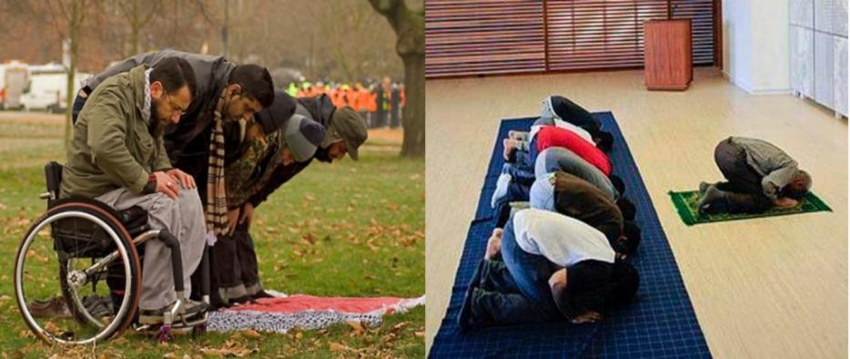
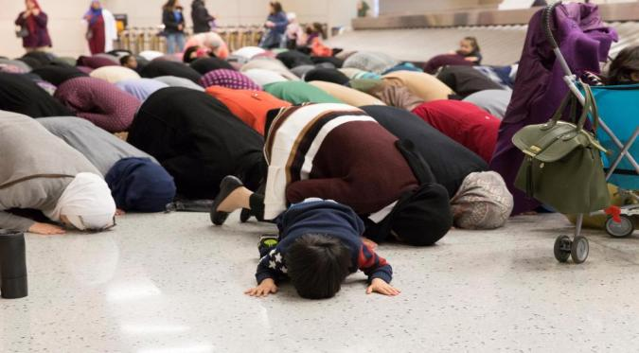
www.jamaatwomen.org

Slide 40
www.jamaatwomen.org

Slide 41
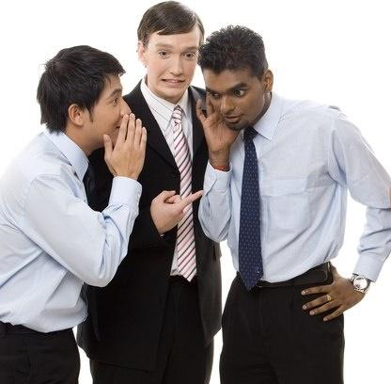
gossips
www.jamaatwomen.org

Slide 42
www.jamaatwomen.org

Slide 43
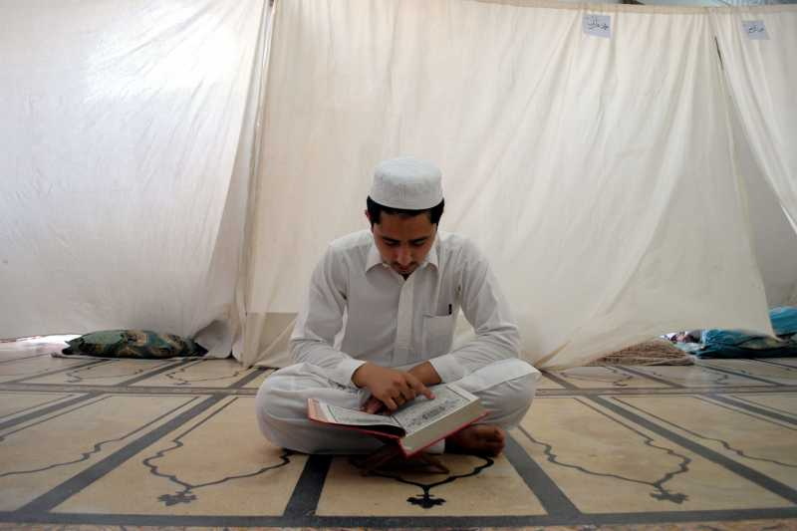
www.jamaatwomen.org

Slide 44
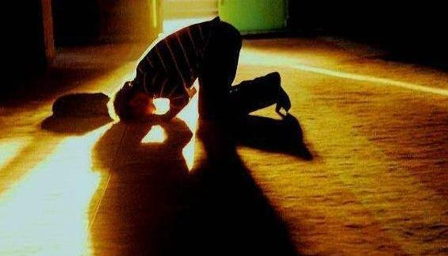

Slide 45
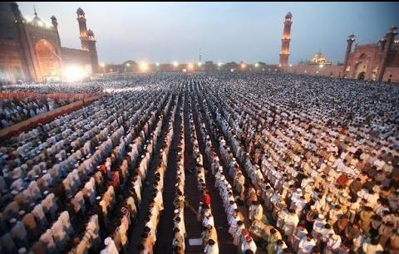
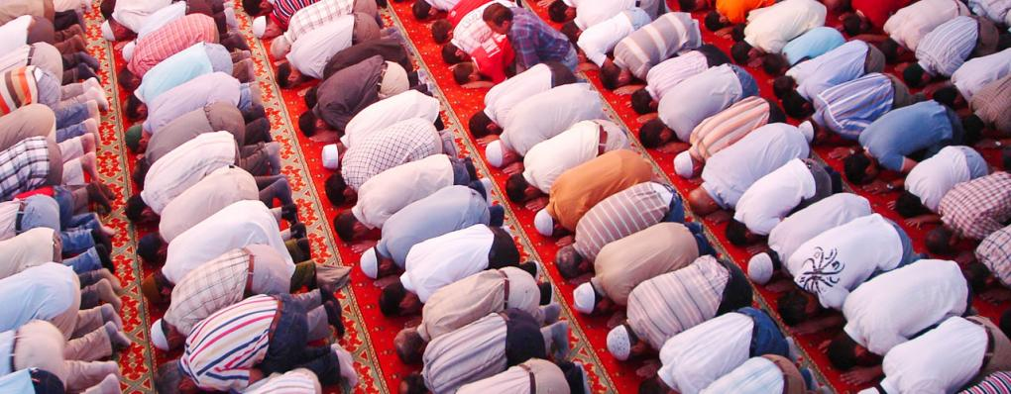
www.jamaatwomen.org

Slide 46
www.jamaatwomen.org

Slide 47
www.jamaatwomen.org

Slide 48
www.jamaatwomen.org

